Slide 1


TRANSCATHETER AORTIC VALVE REPLACEMENT (TAVR)
Milan, April 16th

Slide 2
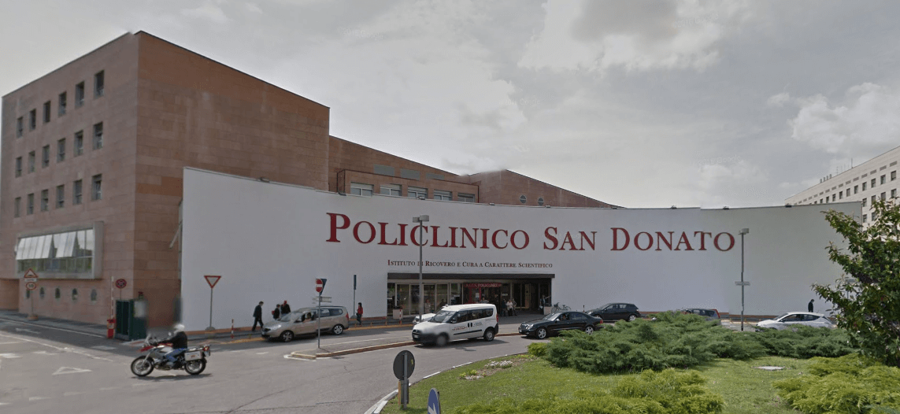



TRANSCATHETER AORTIC VALVE REPLACEMENT (TAVR)

Slide 3






Patient History
Baseline medications
Female, XX years old
Cardiovascular risk factors
Comorbidities
Baseline laboratory data
Creatinine XX mg/dL
eGFR XX ml/min/1.73 m²
Hb: XX g/dL
PLT: XX.000 /mm³

Slide 4
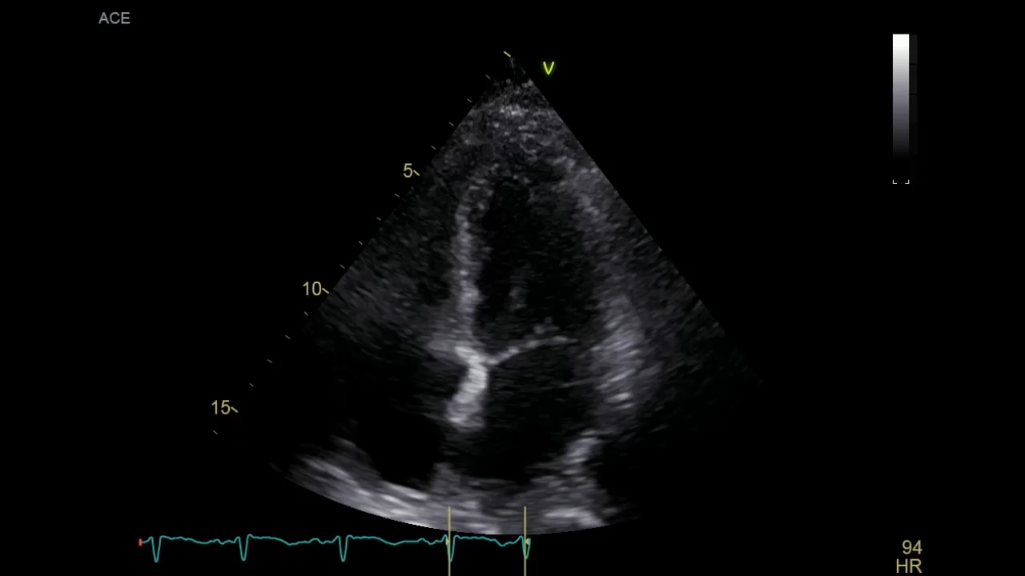
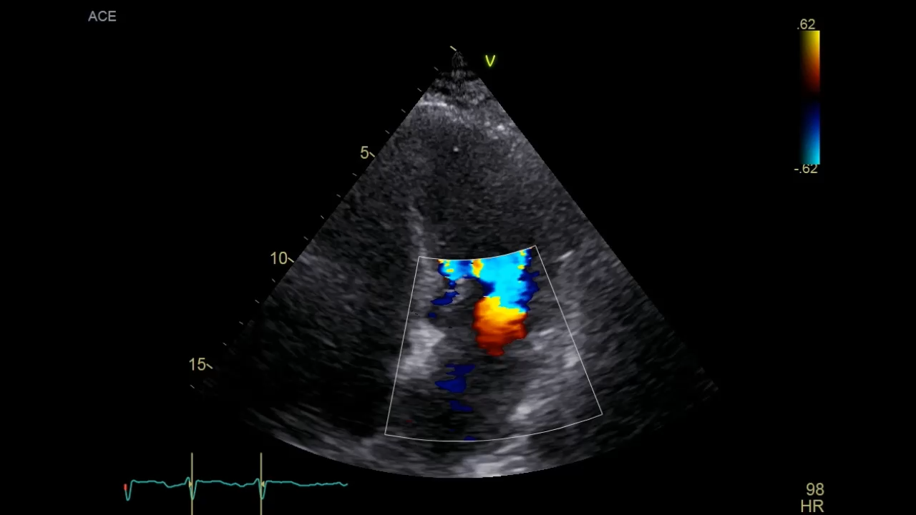
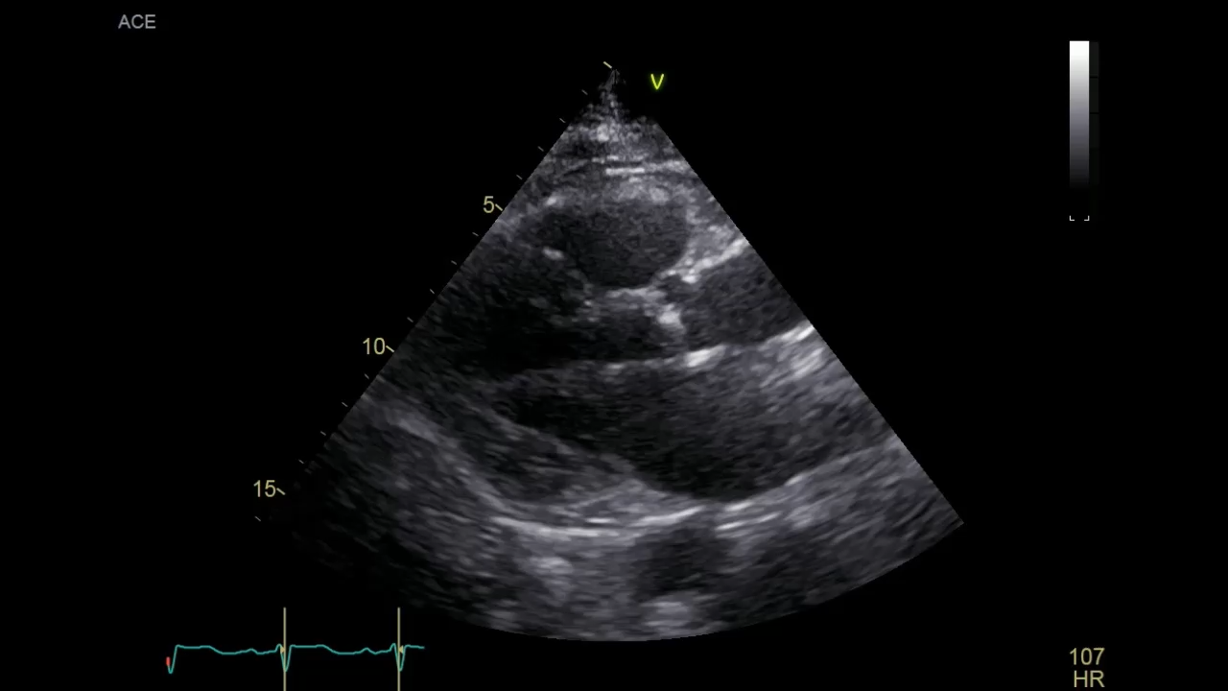
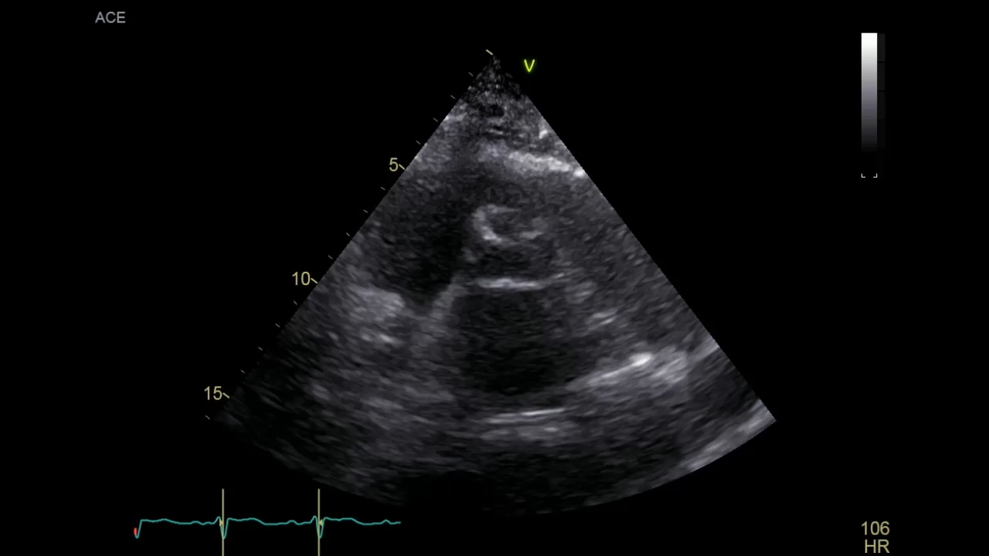
Patient History

Slide 5
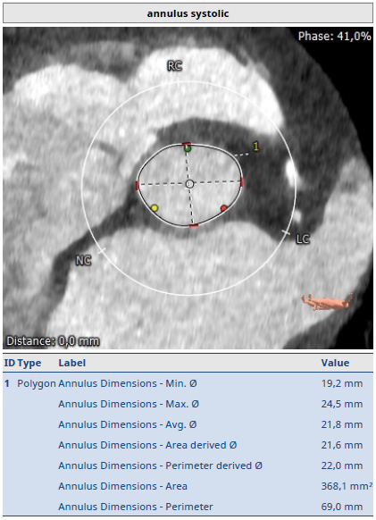
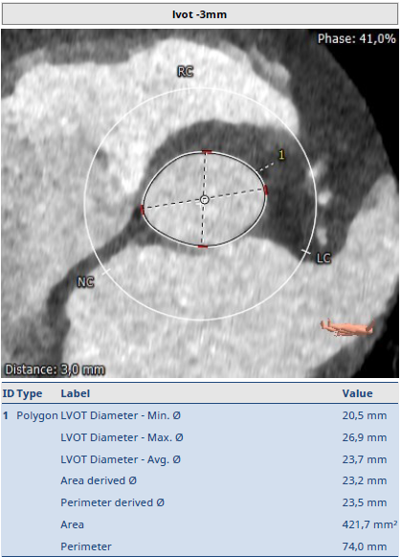
CT EVALUATION

Slide 6
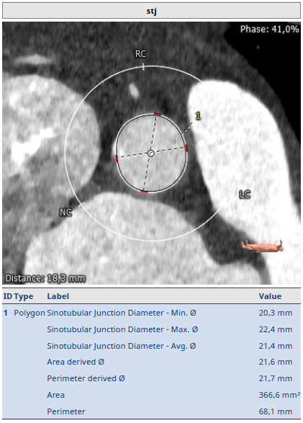
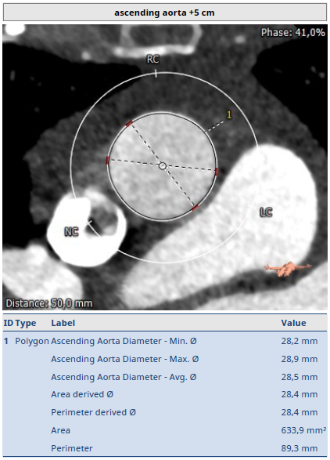
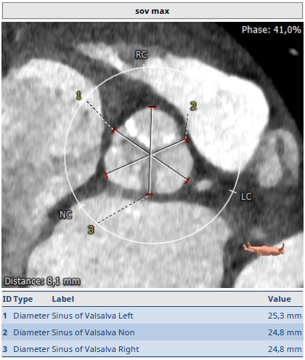
CT EVALUATION

Slide 7
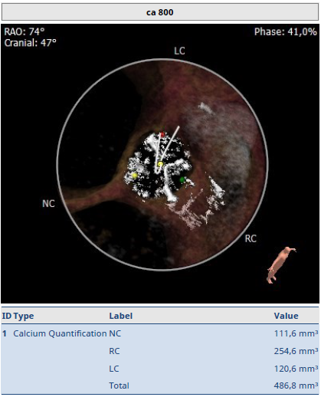
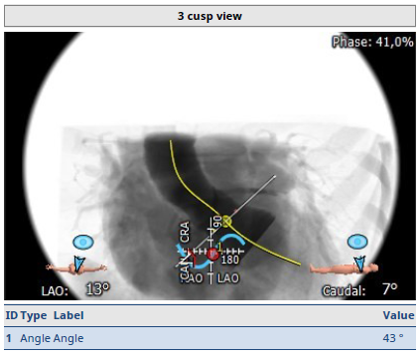
CT EVALUATION

Slide 8
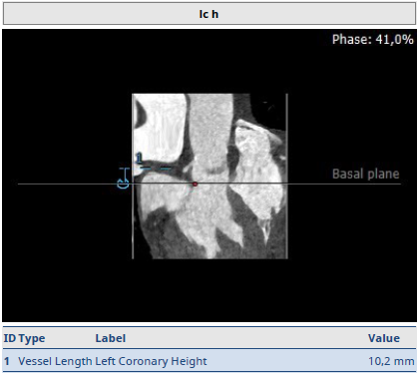
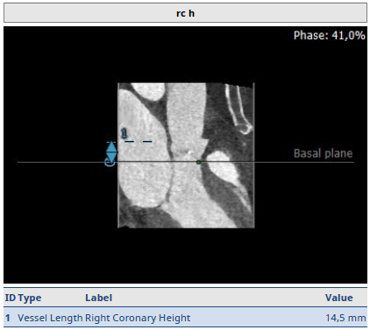
CT EVALUATION

Slide 9
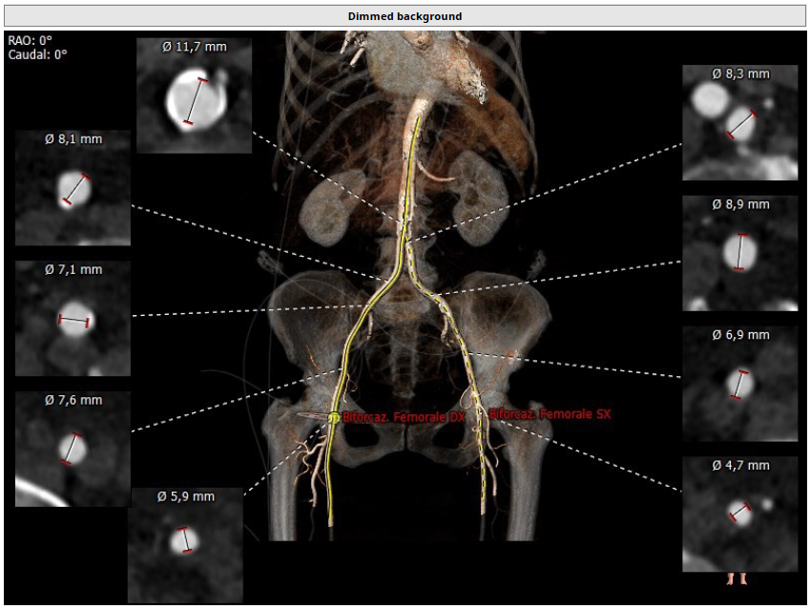
CT EVALUATION

Slide 10
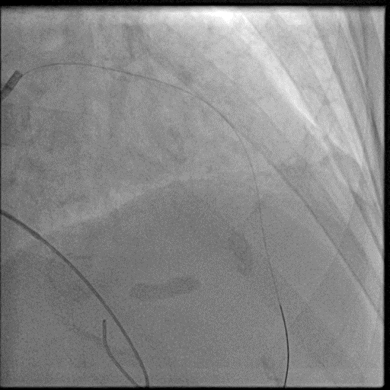
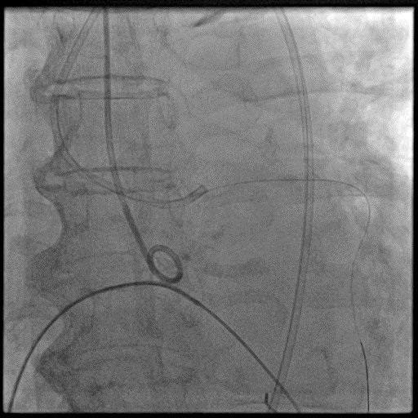
CATH LAB

Slide 11
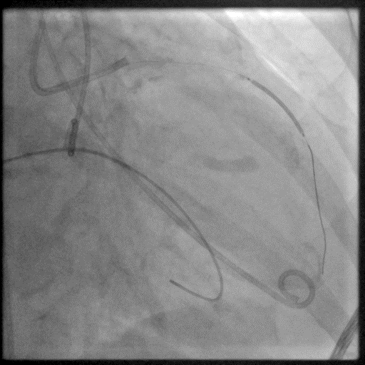
CATH LAB

Slide 12
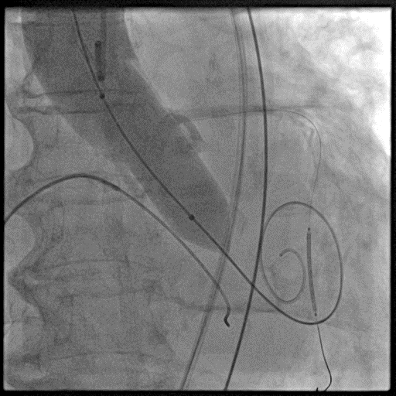
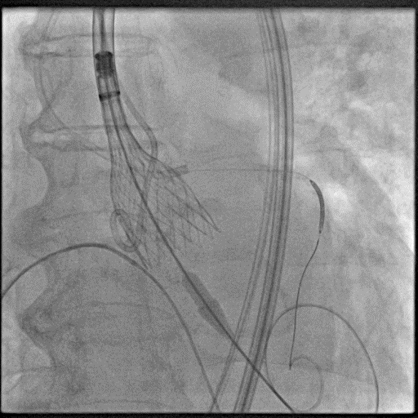
CATH LAB

Slide 13
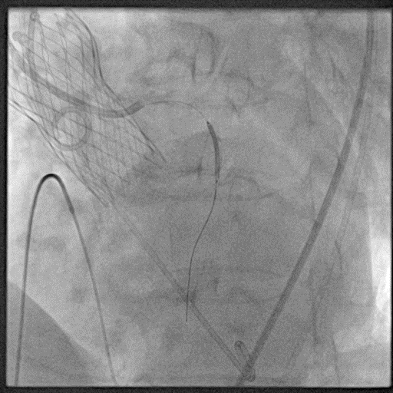
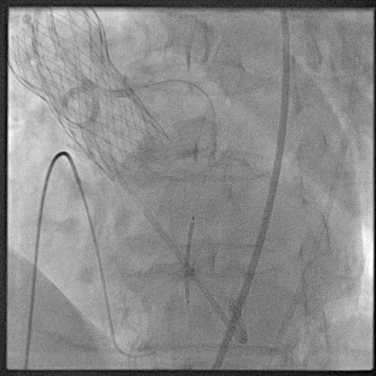
CATH LAB

Slide 14
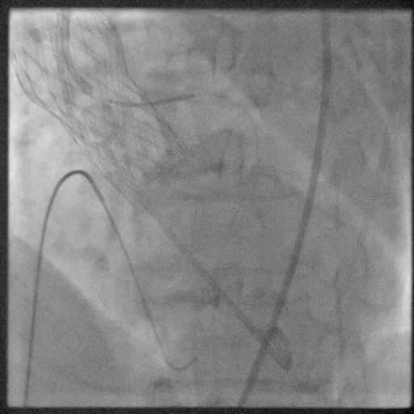
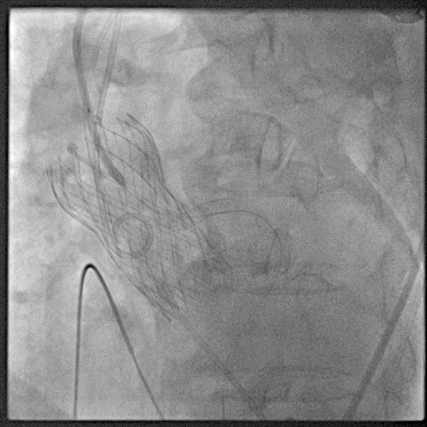
CATH LAB

Slide 15
ENJOY THE CASE!

