Slide 1

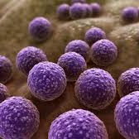
Antibiotic Resistance and Food Safety
Samuele Gagliardi

Slide 2
What is antibiotic resistance?
Antibiotics are used to kill bacteria.
In factory farms, animals get antibiotics even when they are not sick.
This creates “superbugs” – bacteria that antibiotics cannot kill.
These bacteria can spread to humans.

Slide 3
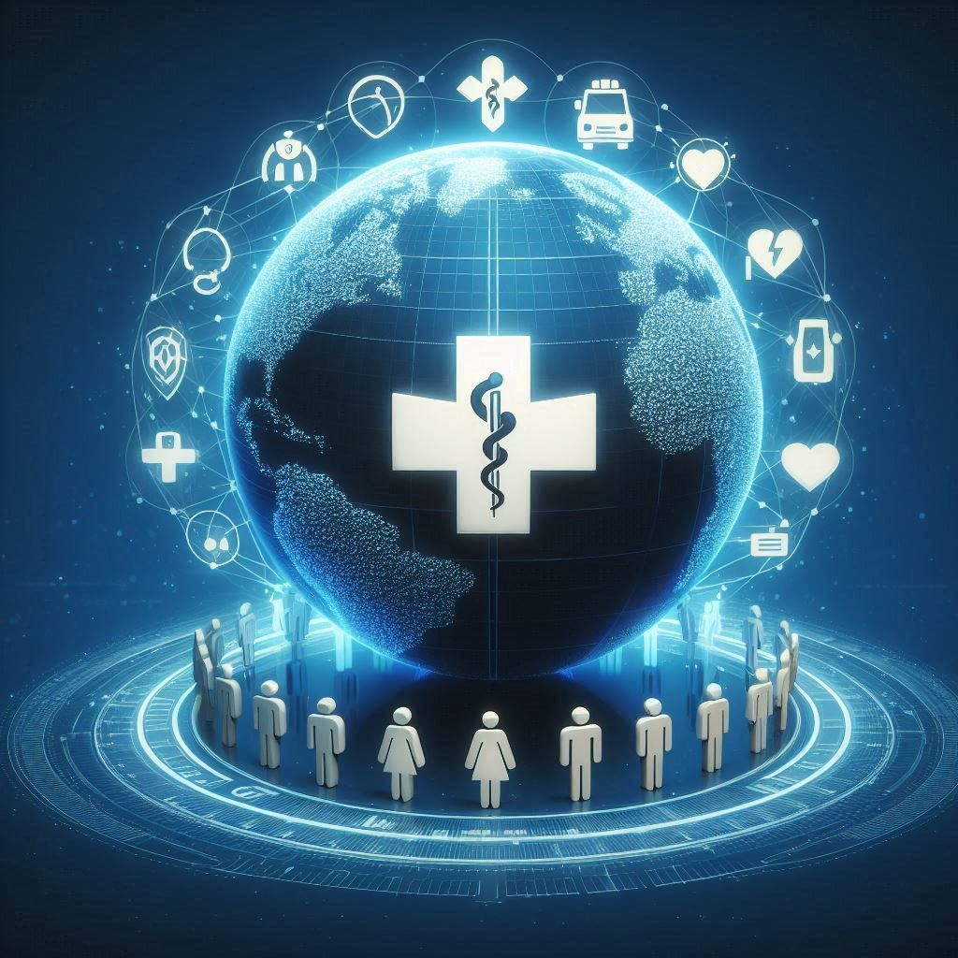
Why Is Antibiotic resistance dangerous?
2 million people in the US get antibiotic-resistant infections every year.
23,000 people die every year because antibiotics don’t work.
In the world, over 700,000 people die each year.
The UN says this is a global health threat.

Slide 4
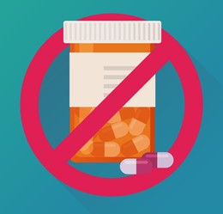
How can we help?
Eat less industrial meat.
Buy meat from farms that don’t use antibiotics.
Look for labels like “antibiotic-free.”
Support laws that protect food safety.

