Slide 1
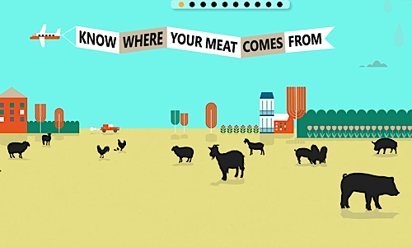
Where our meat comes from
Samuele Gagliardi

Slide 2
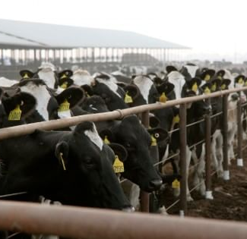
How animals are raised today
Animals live in crowded buildings, not in fields
No natural grazing or behavior
Waste stored in pits, sprayed on land
Pollution and broken farming cycles

Slide 3
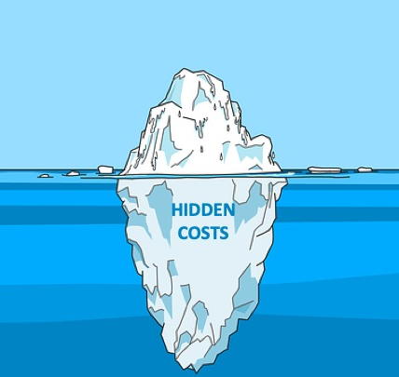
Why is meat so cheap?
Big farms = fast, cheap meat
Government supports big farms
Companies don’t pay for pollution or health damage
Real cost paid by people and the planet

Slide 4
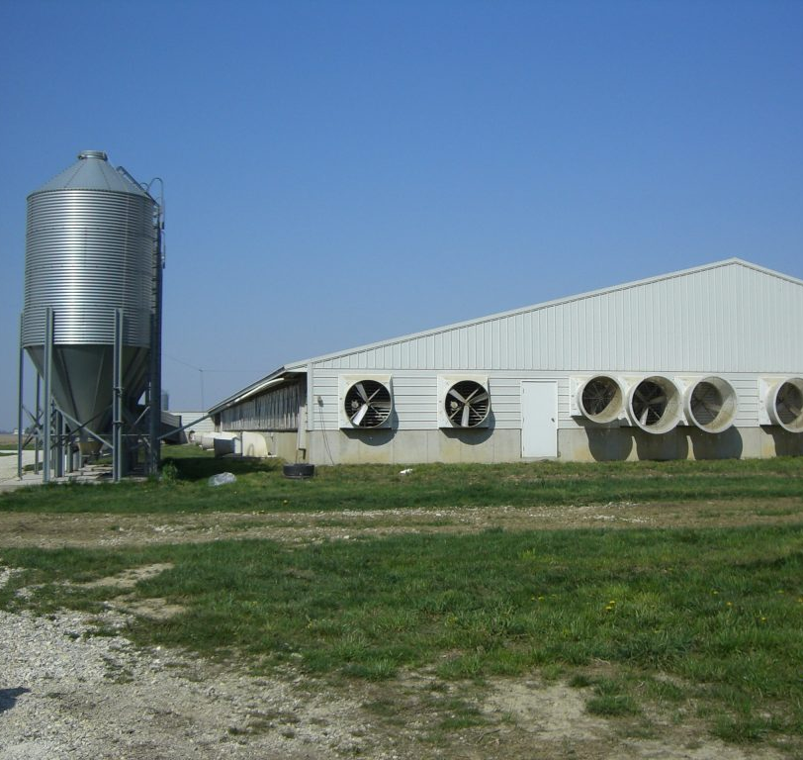
What are AFOs and CAFOs?
AFO = animals kept in one place
CAFO = very large, can pollute water
No grass, no grazing
Most meat comes from CAFOs

