Slide 1
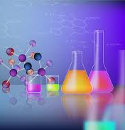
LAB CLEAN-UP

Slide 2

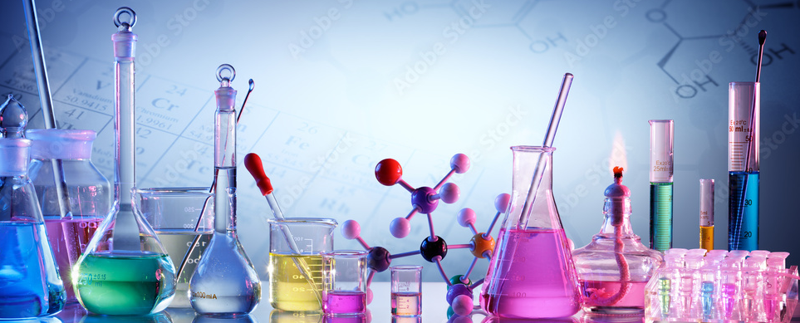
Washing procedures

Slide 3
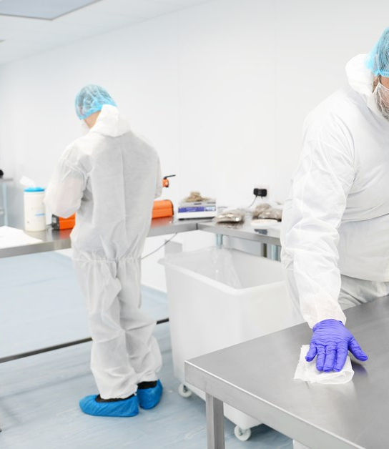
Importance of cleanliness
Cleanliness in the laboratory is very important.
It keeps everyone safe and helps to get correct experimental results.
Before leaving the lab, all benches and working areas must be cleaned carefully.
A clean lab also prevents contamination and damage to equipment.

Slide 4
Materials and tools for cleaning
Different materials and tools are used during clean-up operations:
paper towels
gloves
detergents and soaps
brushes and water
Each material has a specific task: towels for drying, detergents for removing dirt, and gloves for protection.

Slide 5
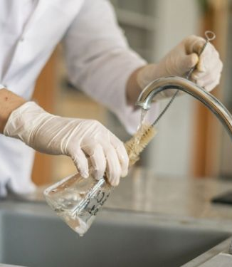
Cleaning instruments and equipment
Sometimes, instruments and laboratory equipment also need special cleaning.
They may require rinsing with pure or de-ionized water, or washing with detergents suitable for laboratory use.
Keeping equipment clean ensures experiments are safe, precise, and reliable.

Slide 6
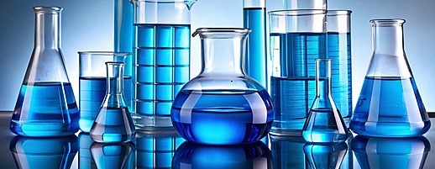
Cleaning of laboratory glassware

Slide 7
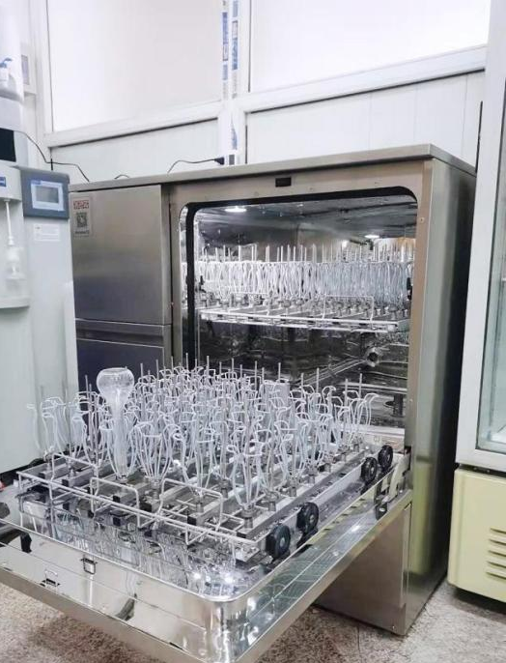
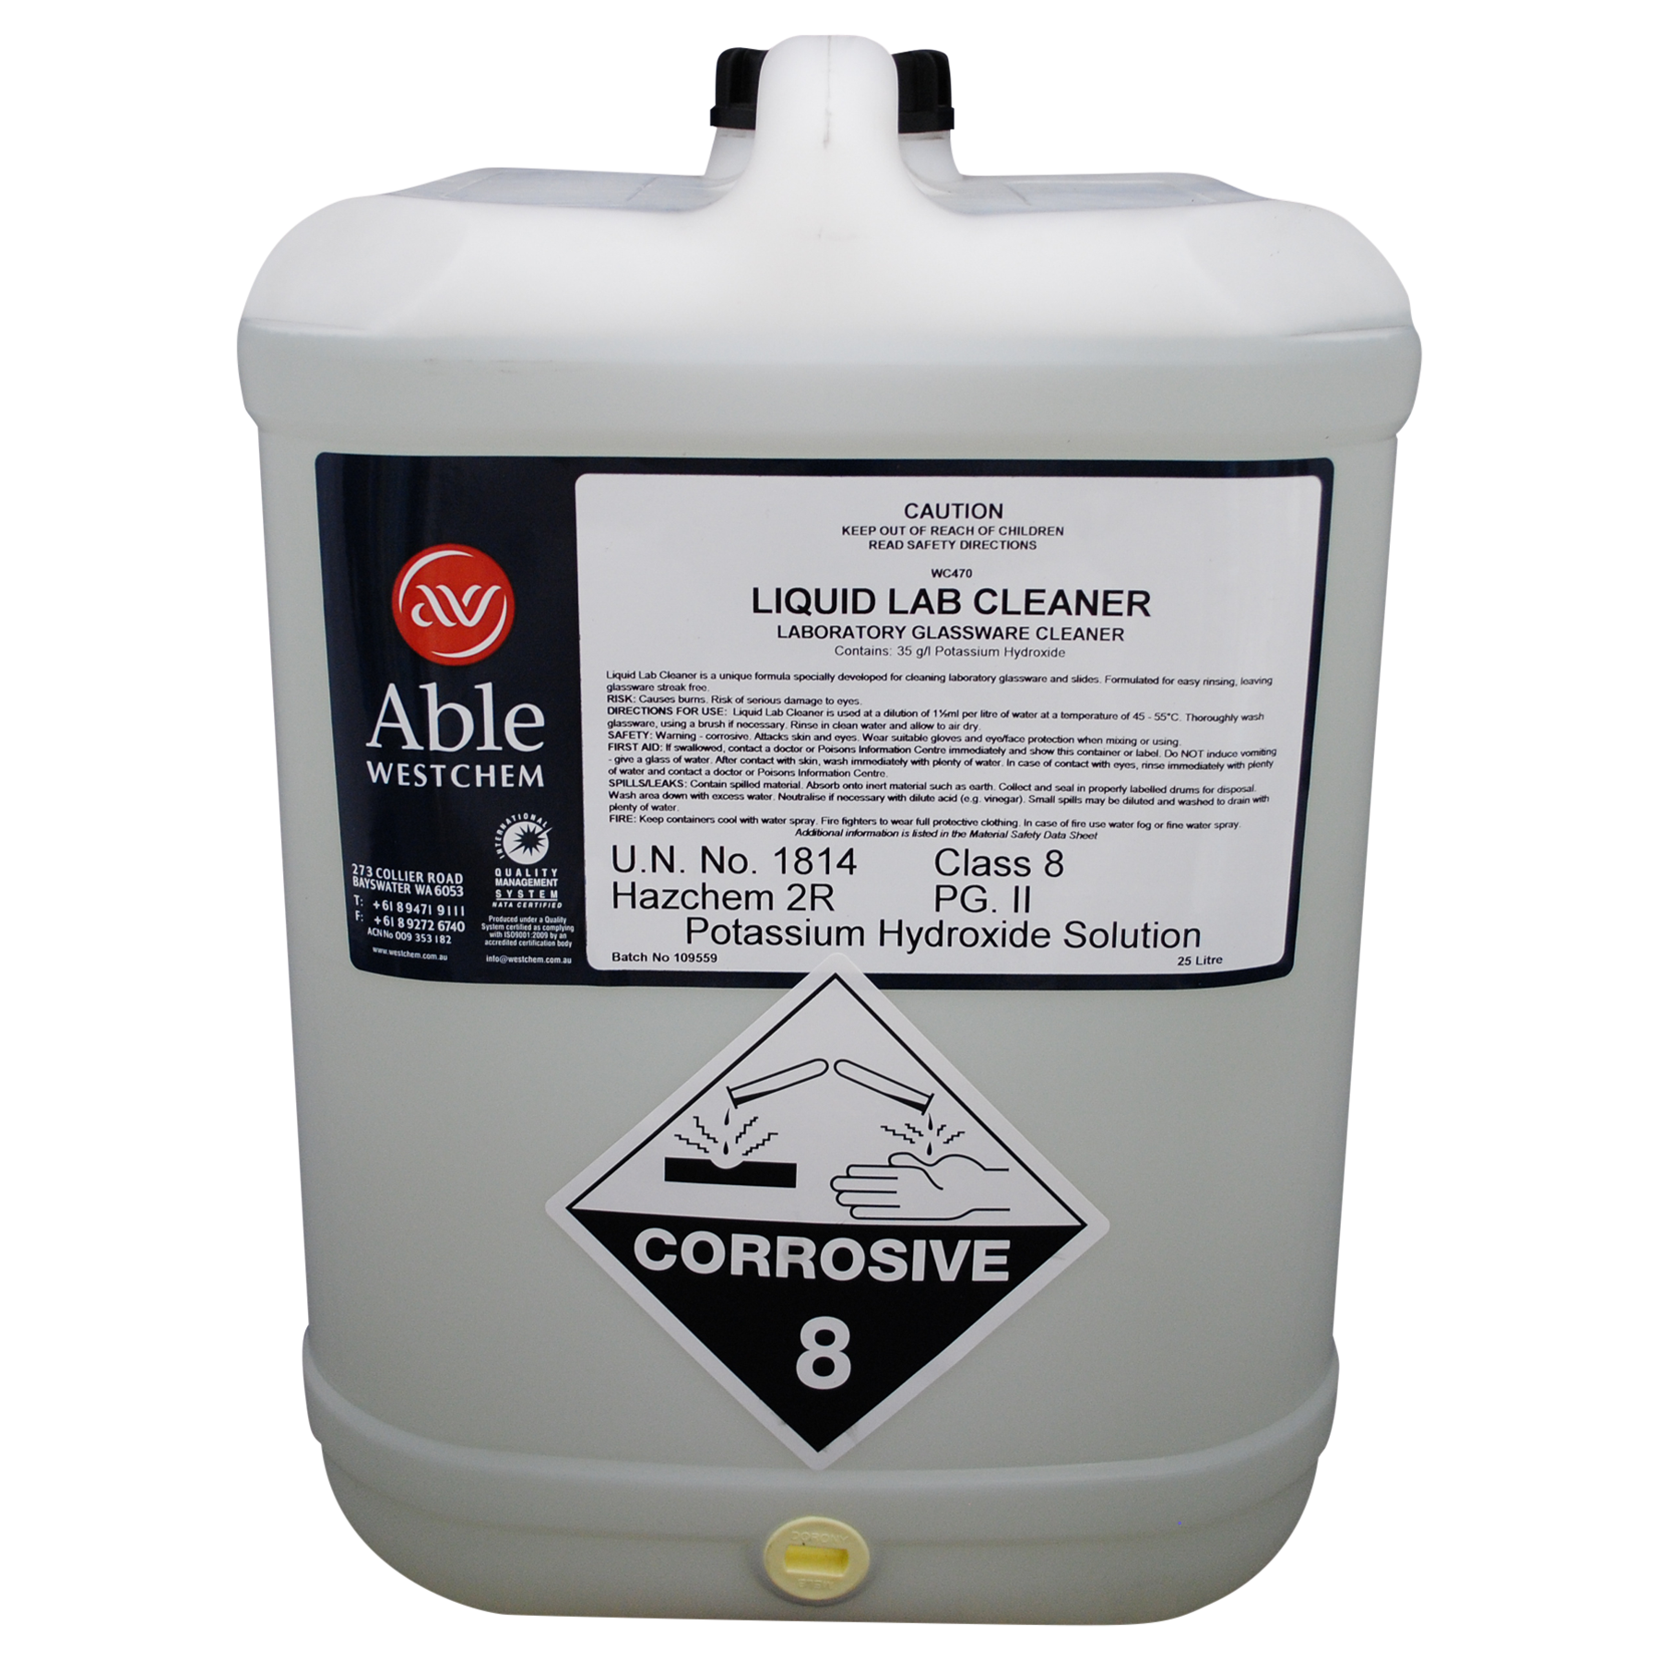
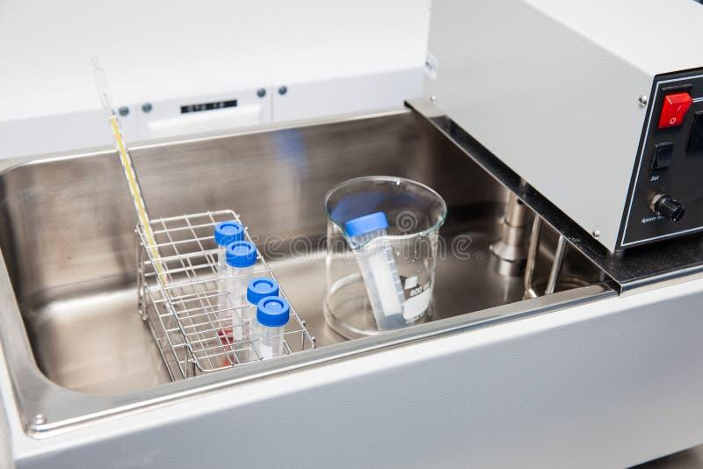
Cleaning glassware
Why?
  Cleaning the glassare Is important because there are some harbour impurities that can react with some chemicals and alter the result of the expirement.
When?
  Galsswere have to wash in a soaking bath or a machine immediately after their use.
Is used a wide range of cleaners and cleaner-disinfectants for boh the methods.
Laboratory washer machine
Soaking bath

Slide 8
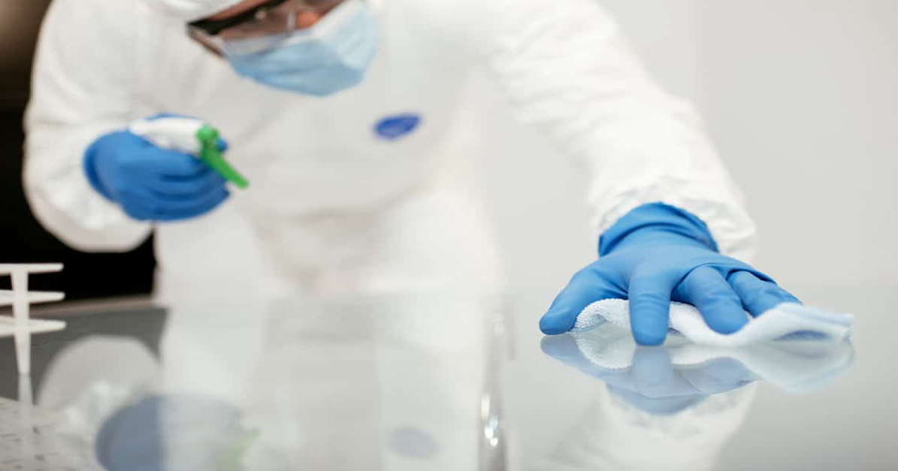
Glassware Cleaning Procedures
Laboratory Maintenance Guidelines

Slide 9
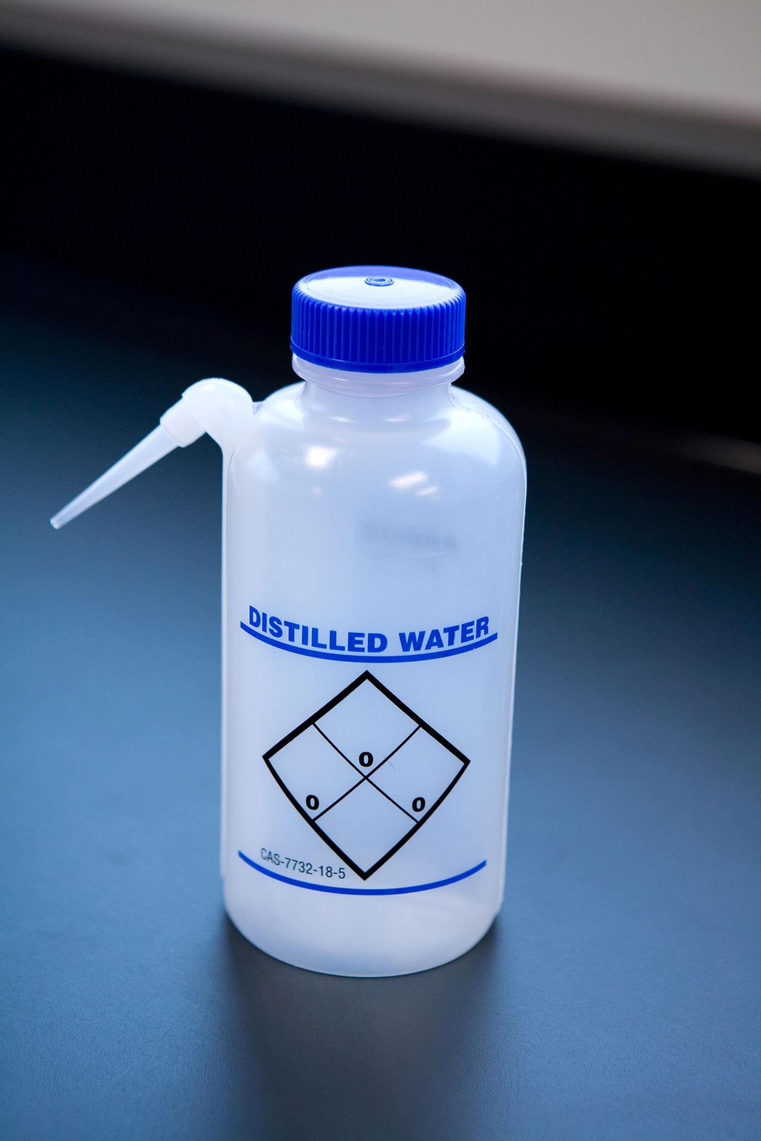
General Procedures
Trascina qui un'immagine
(Inserisci > Immagine > Cerca nel web)
Cleaning depends on chemicals used.
Often no detergent needed.
Standard: Solvent rinse + Deionized water.

Slide 10
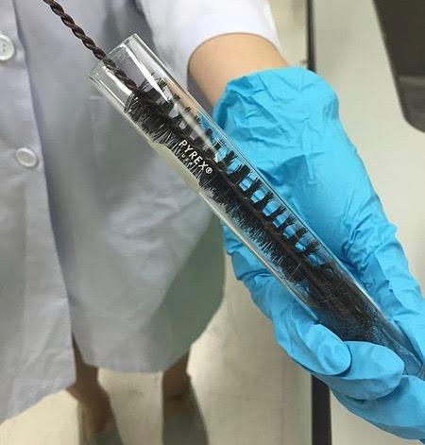
Removing Contaminants
Soaking: Hot detergent for stubborn dirt.
Scrubbing: Use a brush for internal parts.
Trascina qui un'immagine
(Inserisci > Immagine > Cerca nel web)

Slide 11
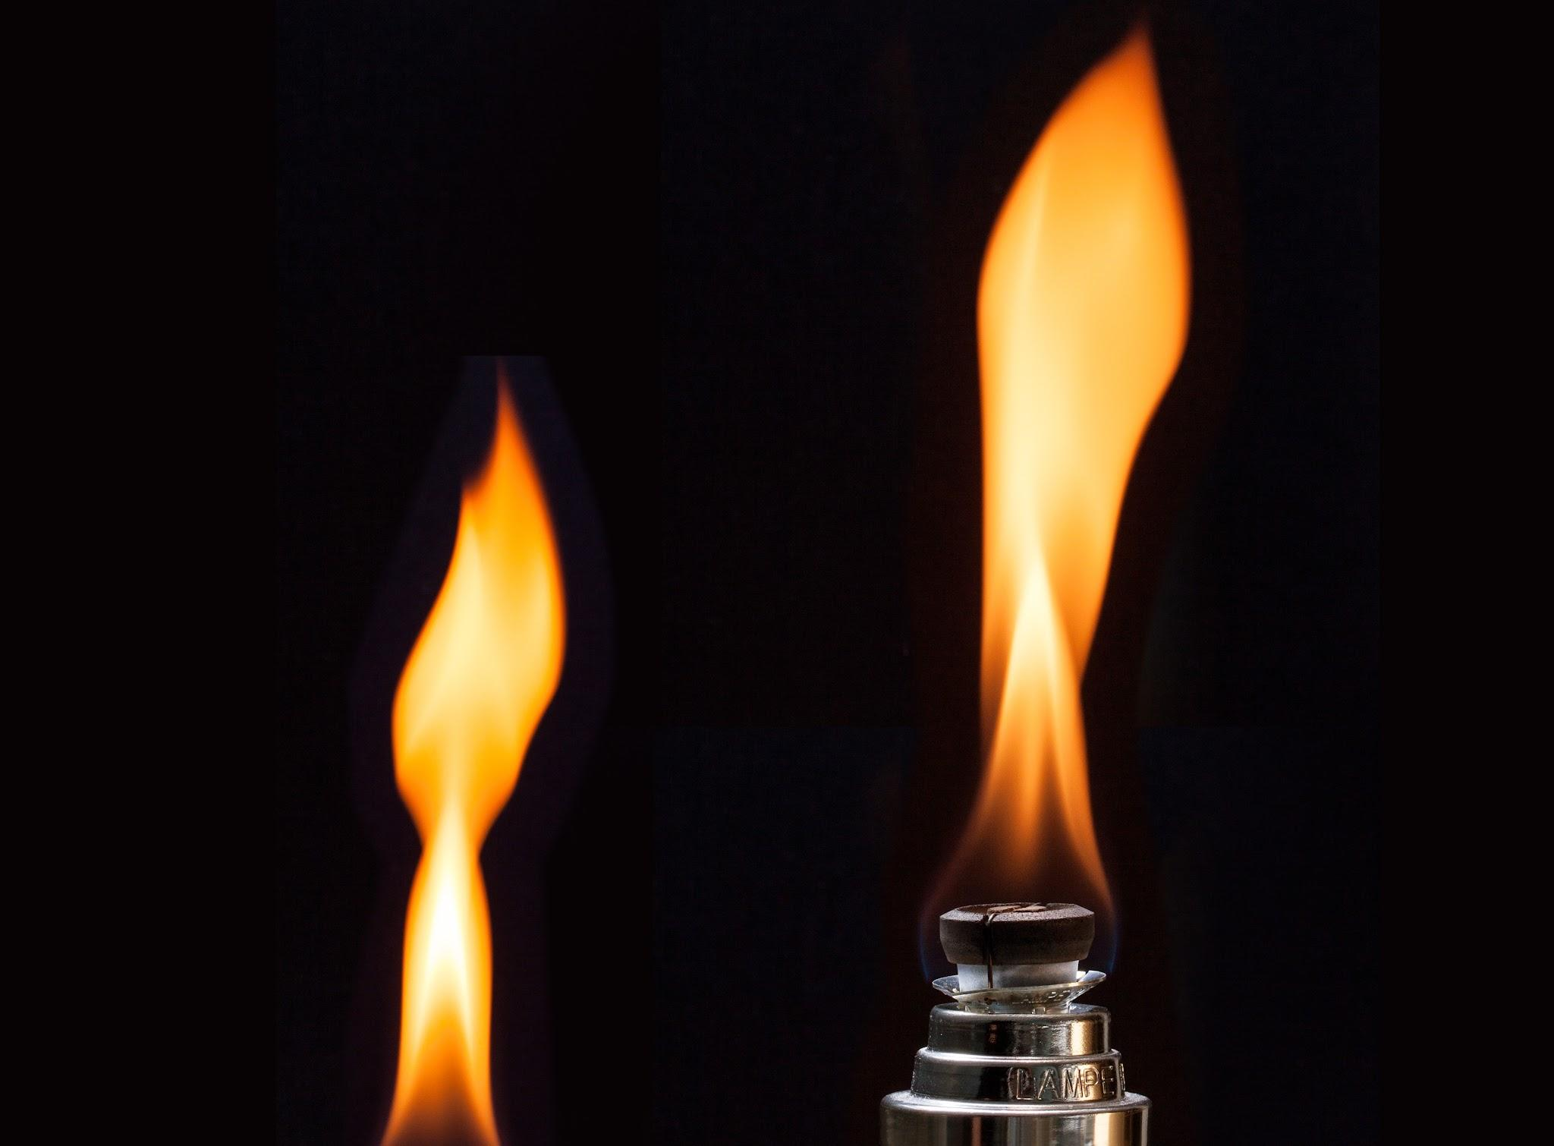
Removing Grease
Boiling: Weak sodium carbonate solution.
Solvents: Acetone or ethanol.
Trascina qui un'immagine
(Inserisci > Immagine > Cerca nel web)

Slide 12
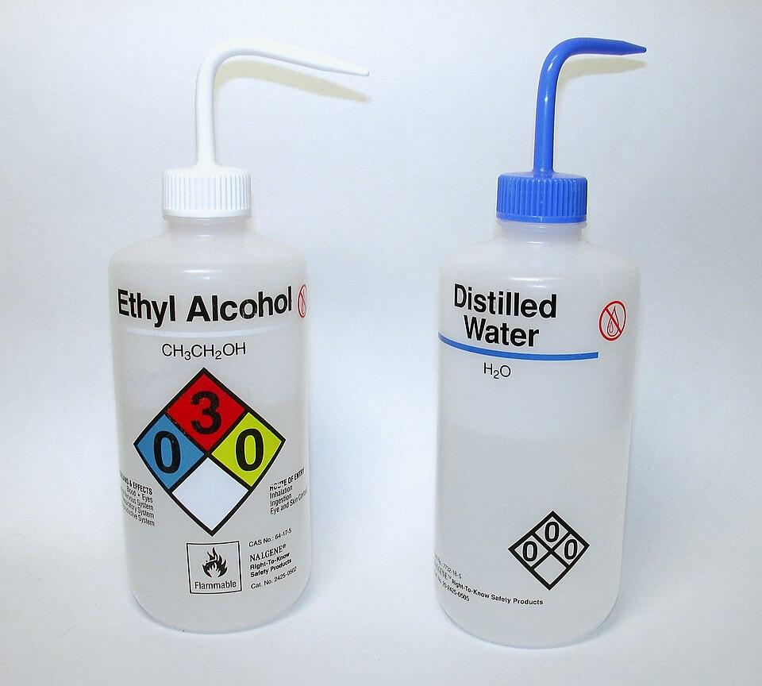
The Final Rinse
CRITICAL:
Always use deionized water
Prevents mineral spots affecting results
Trascina qui un'immagine
(Inserisci > Immagine > Cerca nel web)

Slide 13
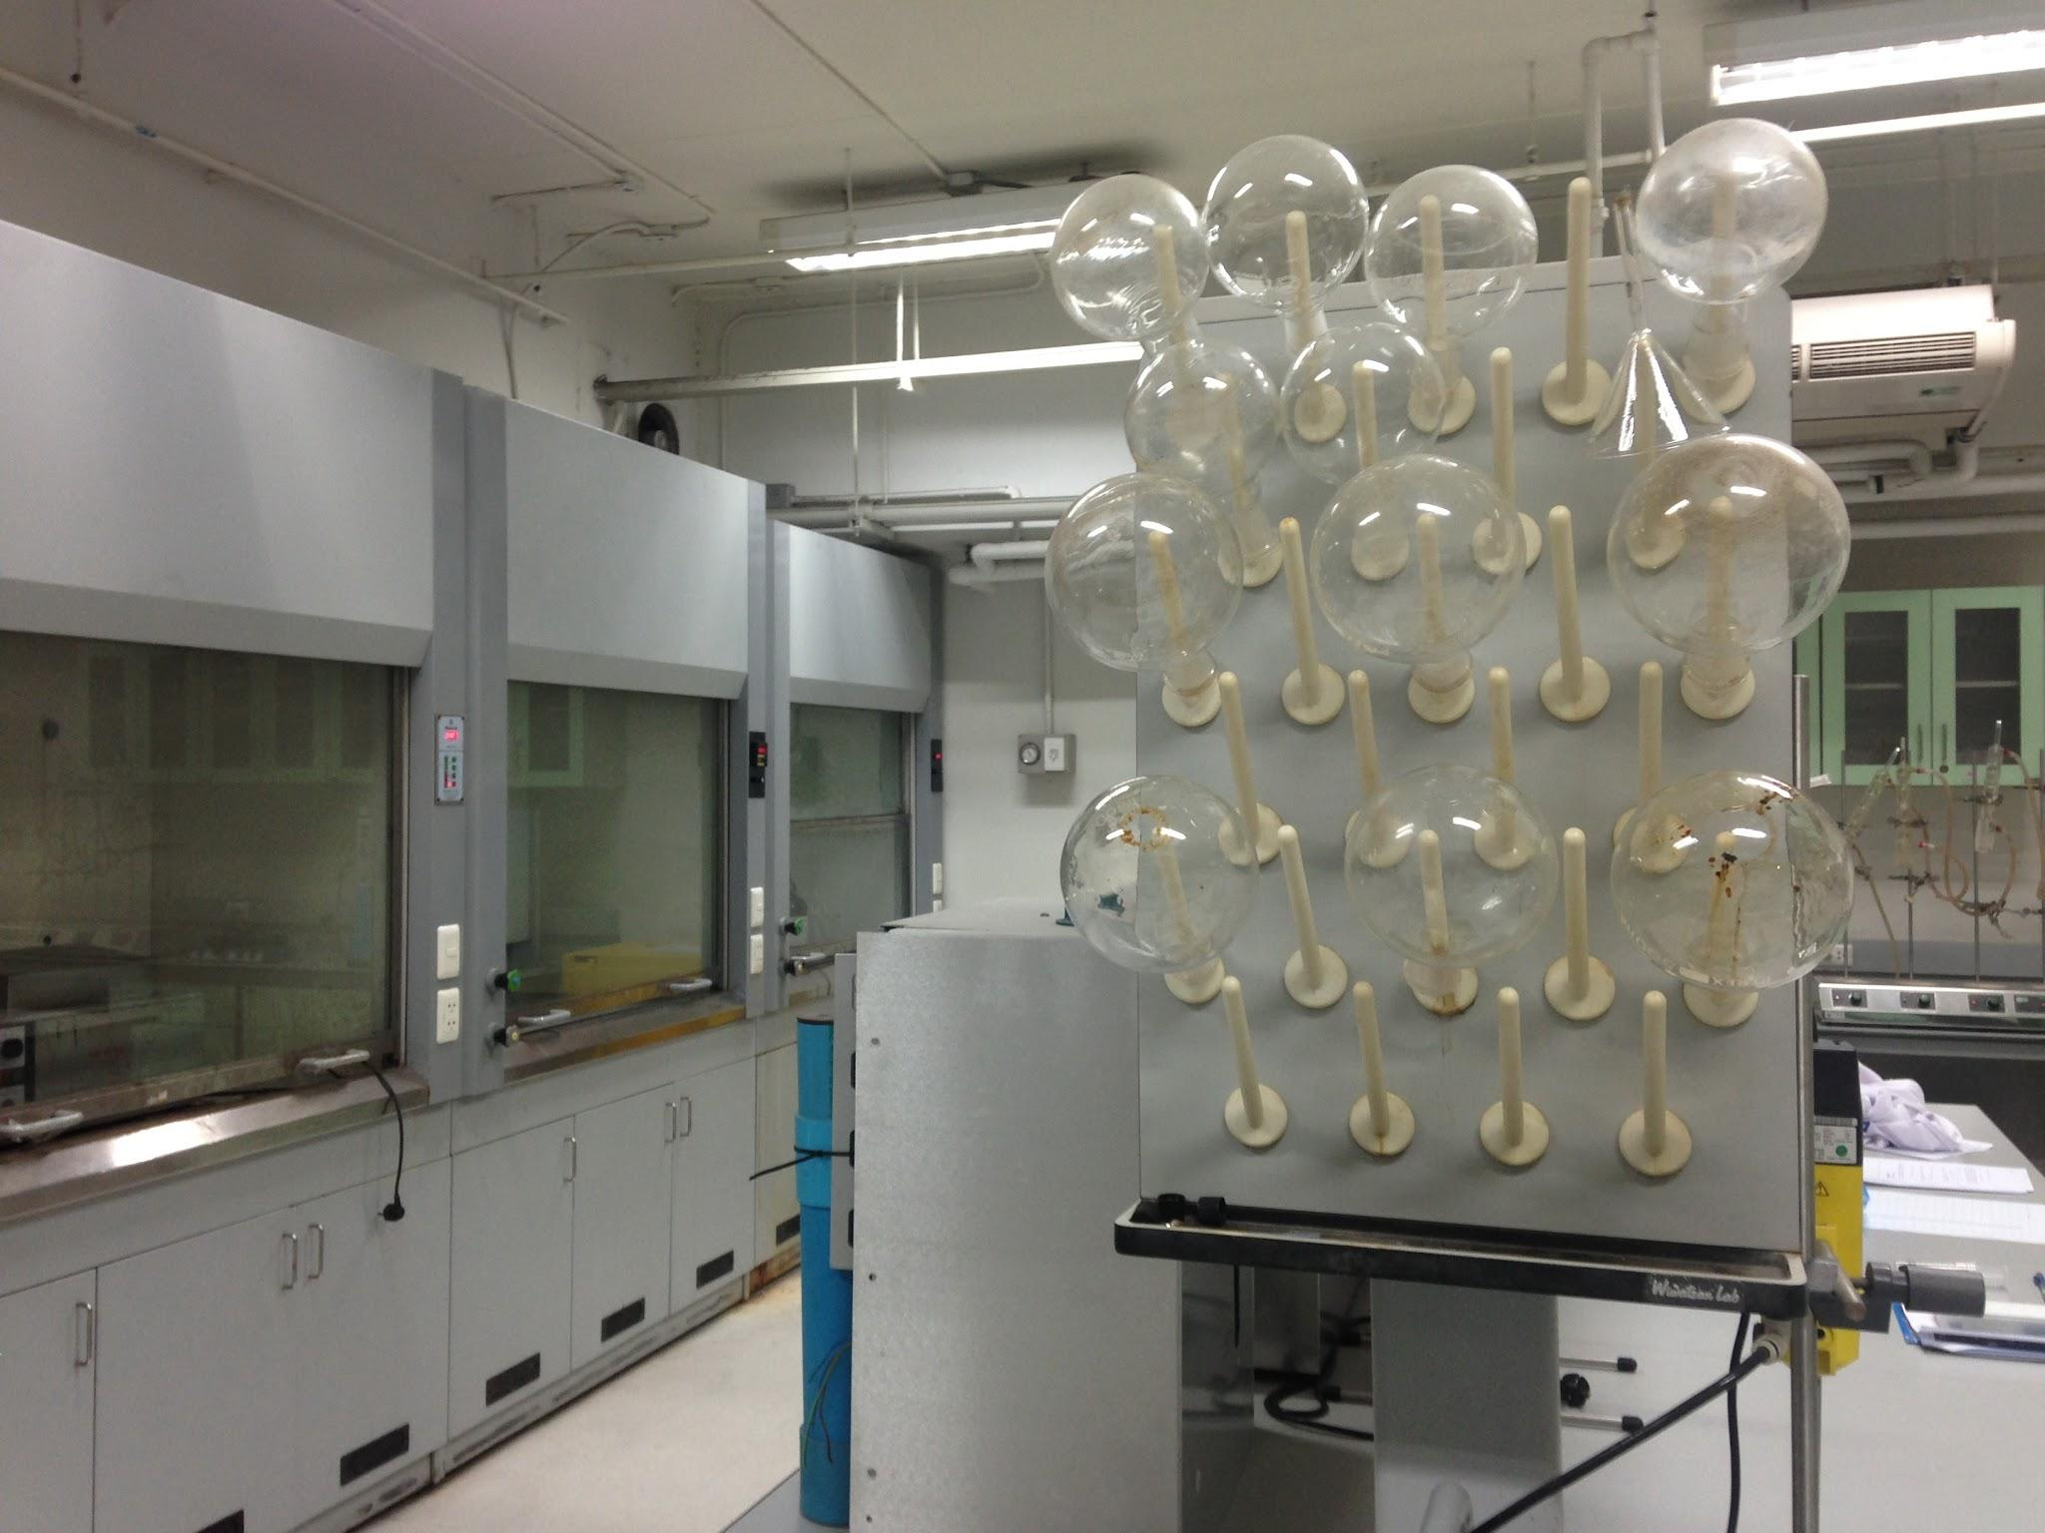
Drying Methods
Trascina qui un'immagine
(Inserisci > Immagine > Cerca nel web)
• Drip-dry on racks.
• Hot air fans or Vacuum.
• Acetone rinse for urgency.

Slide 14
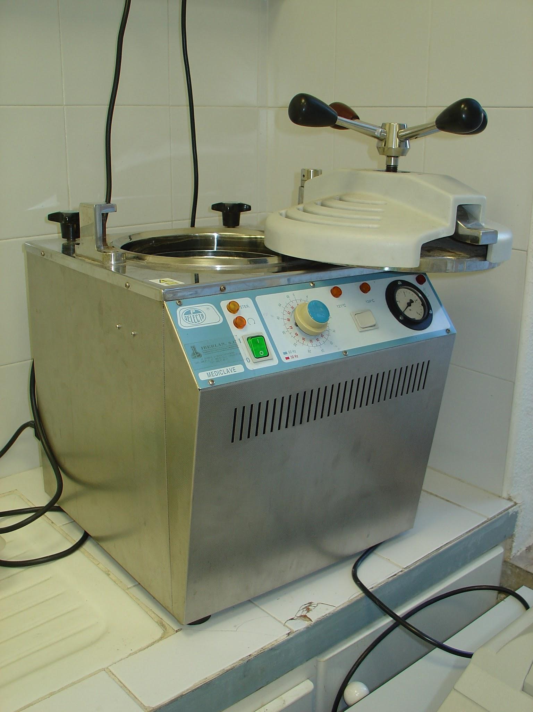
Special Treatments
Trascina qui un'immagine
(Inserisci > Immagine > Cerca nel web)
• Autoclaving: for infectious substances

Slide 15
True or false quiz: Lab clean-up
Cleanliness in the laboratory is only important for safety.
Cleaning the lab also helps to get correct experimental results.
Benches and working areas should be cleaned before starting the experiment.
Paper towels, gloves, detergents and soaps are used for clean-up operations.
Clean-up operations are never required for instruments or equipment.
Keeping the lab clean shows respect for other people’s work.
Gloves are used to dry the benches after cleaning.
Using the right tools makes cleaning easier and safer.
Dirty equipment can affect the results of an experiment.
Instruments should sometimes be rinsed with de-ionized water.

Slide 16
Answers
False – It is important for safety and good results.
True
False – They must be cleaned after the experiment.
True
False – Sometimes they are required for instruments.
True
False – Gloves protect hands, not for drying.
True
True
True

